Slide 1


Unsupervised learning of clusters
=============================================================================
WWW.THEMLLABS.COM || contact@themllabs.com || Phone : 91-7338339898, 91-6362546088

Slide 2
Agenda
Unsupervised learning
Clusters
Clustering methods
Applications
=============================================================================
WWW.THEMLLABS.COM || contact@themllabs.com || Phone : 91-7338339898, 91-6362546088

Slide 3
Unsupervised learning
Unsupervised learning is a type of machine learning or algorithm which learn the patterns without labels.
These algorithms act on the training data without teacher or any guidance.
In these type learning, machine will group the information or data according similarities, pattern and differences between them.
=============================================================================
WWW.THEMLLABS.COM || contact@themllabs.com || Phone : 91-7338339898, 91-6362546088

Slide 4
Clusters
Clusters are the types of unsupervised learning.
Clustering is the process of dividing the data points into the groups such that points in one group is different from the point in another group and similar to the point in same group.
Clusters may take any shape depending on the data points positions.
=============================================================================
WWW.THEMLLABS.COM || contact@themllabs.com || Phone : 91-7338339898, 91-6362546088

Slide 5
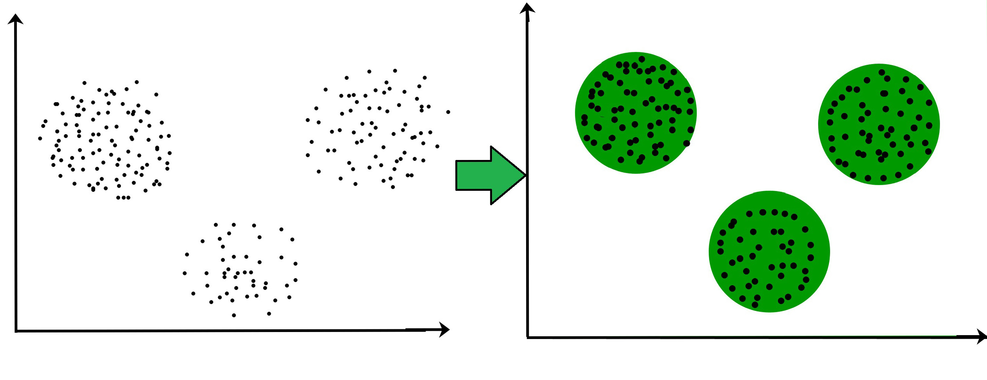
Example: The data points which are closer to one another are formed as one cluster. There are 3 clusters.
=============================================================================
WWW.THEMLLABS.COM || contact@themllabs.com || Phone : 91-7338339898, 91-6362546088

Slide 6
Clustering methods
Density based methods:
These methods consider the clusters as dense region having some similarity and different from lower region of space.
Density based methods have good accuracy and ability to merge two clusters.
Example: DBSCAN (Density based spatial clustering of applications with noise), OPTICS (Ordering policy to identify clustering structure).
=============================================================================
WWW.THEMLLABS.COM || contact@themllabs.com || Phone : 91-7338339898, 91-6362546088

Slide 7
2. Hierarchical based methods:
The clusters formed in this method forms the tree like structure based on hierarchy.
New clusters are formed using the previous one.
It is again divided into Agglomerative (bottom up) and Divisive (top down).
Examples: CURE (Clustering using representatives), BIRCH (Balanced iterative reducing clustering using hierarchies)
=============================================================================
WWW.THEMLLABS.COM || contact@themllabs.com || Phone : 91-7338339898, 91-6362546088

Slide 8
3. Partitioning methods:
In these method, objects are partitioned into k clusters and each partition forms one cluster.
It is used to optimize an objective criterion similarity function.
Example: K-means, CLARANS (clustering large application based upon randomized search).
=============================================================================
WWW.THEMLLABS.COM || contact@themllabs.com || Phone : 91-7338339898, 91-6362546088

Slide 9
4. Grid based methods:
In this method, data space is formulated into finite number of cells that forms grid structure.
The clustering operations done on grids are fast and independent of the number of data objects.
Examples: STING (statistical information grid), wave cluster.
=============================================================================
WWW.THEMLLABS.COM || contact@themllabs.com || Phone : 91-7338339898, 91-6362546088

Slide 10
Applications
In marketing, it can be used to characterize and discover customer segments.
It can be used to classify different species of plants and animals.
Based on the topics and information, it can be used to cluster the different books in the library.
It can be used to acknowledge the customers, their policies and fraud identification. etc.
=============================================================================
WWW.THEMLLABS.COM || contact@themllabs.com || Phone : 91-7338339898, 91-6362546088

Slide 11
Thank you
=============================================================================
WWW.THEMLLABS.COM || contact@themllabs.com || Phone : 91-7338339898, 91-6362546088

